Slide 1

Sir Syed University of Engineering & Technology, Karachi
CS-468 Software Quality Assurance & Testing
Week 2
Session 1

Slide 2
Software Errors, Faults & Failure…
Software errors are sections of the code that are partially or totally incorrect as a result of a grammatical, logical or other mistake made by a systems analyst, a programmer, or another member of the software development team.
Software faults are software errors that cause the incorrect functioning of the software during a specific application.
Software faults become software failures only when they are “activated”, that is, when a user tries to apply the specific software section that is faulty. Thus, the root of any software failure is a software error.

Slide 3
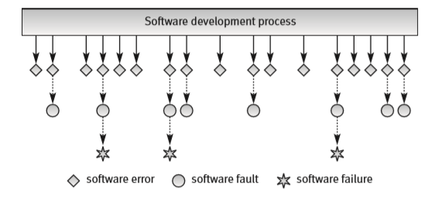
… Software Errors, Faults & Failure …

Slide 4
Why Software Error Occurs
When something fairly obvious missed.
To understand this we need to start at the beginning, with the people who design systems.
Do they make mistakes? Of course they do.
People make mistakes because they are fallible, but there are also many pressures that make mistakes more likely. Pressures such as deadlines, complexity of systems and organizations, and changing technology all bear down on designers of systems
and increase the likelihood of errors in specifications, in designs and in software code.
These errors are where major system failures usually begin.
If a document with an error in it is used to specify a component the component will be faulty and will probably exhibit incorrect behavior.
If this faulty component is built into a system the system may fail. While failure is not always guaranteed, it is likely that errors in specifications will lead to faulty components and faulty components will cause system failure.

Slide 5
Why System Fails
An error (or mistake) leads to a defect, which can cause an observed failure.
There are other reasons why systems fail.
Environmental conditions such as the presence of radiation, magnetism, electronic fields or pollution can affect the operation of hardware and firmware and lead to system failure.
If we want to avoid failure we must either avoid errors and faults or find them and rectify them. Testing can contribute to both avoidance and rectification, as we will see when we have looked at the testing process in a little more detail.
One thing is clear: if we wish to influence errors with testing we need to begin testing as soon as we begin making errors – right at the beginning of the development process – and we need to continue testing until we are confident that there will be no serious system failures – right at the end of the development process.

Slide 6
Problems of Faulty Software
Incorrect software can harm:
people (e.g. by causing an aircraft crash in which people die, or by causing a hospital life support system to fail);
companies (e.g. by causing incorrect billing, which results in the company losing money);
the environment (e.g. by releasing chemicals or radiation into the atmosphere).
Software failures can sometimes cause all three of these at once.
Software failures, then, can lead to:
Loss of money
Loss of time
Loss of business reputation
Injury
Death

Slide 7
9 Causes of software errors ...
Faulty requirements definition
Client–developer communication failures
Deliberate deviations from software requirements
Logical design errors
Coding errors
Non-compliance with documentation and coding instructions
Shortcomings of the testing process
Procedure errors
Documentation errors

Slide 8
... 9 Causes of software errors ...
Faulty requirements definition
Wrong definition of requirements.
Absence of vital requirements.
Incomplete definition of requirements.
Inclusion of unnecessary requirements, functions that are not expected to be needed in the near future.

Slide 9
... 9 Causes of software errors ...
Client–developer communication failures
Misunderstanding of the client’s instructions as stated in the requirement document.
Misunderstanding of the client’s requirements changes presented to the developer in written form during the development period.
Misunderstanding of the client’s requirements changes presented orally to the developer during the development period.
Misunderstanding of the client’s responses to the design problems presented by the developer.
Lack of attention to client messages referring to requirements changes and to client responses to questions raised by the developer on the part of the developer.

Slide 10
... 9 Causes of software errors ...
Deliberate deviations from software requirements
The developer reuses software modules taken from an earlier project without sufficient analysis of the changes and adaptations needed to correctly fulfil all the new requirements.
Due to time or budget pressures, the developer decides to omit part of the required functions in an attempt to cope with these pressures.
Developer-initiated, unapproved improvements to the software, introduced without the client’s approval, frequently disregard requirements that seem minor to the developer. Such “minor” changes may, eventually, cause software errors.

Slide 11
... 9 Causes of software errors ...
Logical design errors
Software errors can enter the system when the professionals who design the system – systems architects, software engineers, analysts, etc. – formulate the software requirements. Typical errors include:
Definitions that represent software requirements by means of erroneous algorithms.
Process definitions that contain sequencing errors.
Erroneous definition of boundary conditions.
Omission of required software system states.
Omission of definitions concerning reactions to illegal operation of the software system.

